Slide 1

Our Prayers and Christ’s Position
1:15 – 23
Week 16
11 May 2022

Slide 2

Ephesians overview
The last half of the chapter contains Paul’s first of two prayers that are in this epistle. The prayer in this chapter is for their “enlightenment,” that their knowledge and understanding might increase. Paul especially desires that they might know God more fully, what is the hope of His calling, what are the riches of the glory of His inheritance in the saints, and what is the great power of God toward those who believe (15-19).
Regarding this “power,” it is the same power God used to raise Jesus from the dead and seat Him at His right hand. The exalted position now enjoyed by Christ includes authority over all things, especially the church which is described as “His body, the fullness of Him who fills all in all” (20-23).

Slide 3


Slide 4
Ephesians overview
Ephesians was written by a man who really knew how to pray. On the heels of a magnificent flourish of praise (1:3-14), Paul changes gears and continues with purposeful intercession for his readers. He recounts to them the content of his prayers for them, including heartfelt thanksgiving and profound petition to God on their behalf.
You can’t read about Paul’s prayer for the Ephesians and fail to catch his deep passion. Paul prayed like he meant it. In doing so, he gave us a stunning example of genuine prayer.

Slide 5
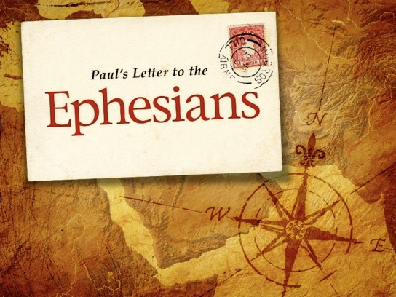
Our Prayers and Christ’s Position

Slide 6
Ephesians 1:15 – 16
¹⁵For this reason, ever since I heard about your faith in the Lord Jesus and your love for all God’s people, ¹⁶I have not stopped giving thanks for you, remembering you in my prayers.

Slide 7
Ephesians 1:15 – 16
Ephesians 1:15 begins the account of Paul’s prayer of thanksgiving and supplication for the Ephesian Christians, and it runs all the way to the end of the chapter.
Verses 15-16 includes his personal thanksgiving for the Ephesians.
Verses 17-19 reveals the things Paul prayed for on the Ephesians’ behalf.
Finally, verses 20-23 refers to the power of Paul’s prayer—the resurrected and ascended Lord.

Slide 8
Ephesians 1:15 – 16
Paul notes that he never ceased to lift up his Ephesian brothers and sisters, mentioning them whenever he prayed (1:16). When we consider the numerous places throughout the empire where Paul had established churches, we can imagine all the regions, cities, and even families that he must have included on his prayer list.
Here was a man committed to prayer! Virtually every time he bowed his knees before the Father in prayer, the name “Ephesus” was on his lips. Yet Paul goes deeper than a polite, “Oh, by the way, I just want you to know I’m praying for you.” Instead, he reveals specific things that he mentions in his prayers.

Slide 9
Ephesians 1:15 – 16
Ephesians 1:15 reveals the basis for Paul’s thankfulness: The Ephesians’ reputation of faith in Christ and the love they exhibit for the saints. The faith Paul refers to is not their original conversion. Paul himself had already spent enough time with the Ephesians to know the genuineness of their original faith in Christ. Rather, he’s referring to the condition of their faith as they grew in Christ.
Over the years, the Ephesians’ faith had grown steadily stronger. They had built well on the foundation laid by Paul and other minister (cf. 1Cor 3:10), and their reputation for faith had reached Paul’s ears. Like a proud father who continually hears news of a famous child’s success, Paul expresses his gratitude to God for the spiritual growth of the Ephesians.

Slide 10
Ephesians 1:15 – 16
Today, many Christians tiptoe gingerly through the Christian life, afraid of stumbling, unsure about whether the path of faith on which they’re traveling might lead them into danger. When they hear strange noises, they cower. When darkness sets in, they hesitate. And when obstacles fall in their path, they panic.
But not the Ephesians—with the illuminating light of faith, they marched forward, bold and strong, advancing in the Christian life toward spiritual adulthood.

Slide 11
Ephesians 1:15 – 16
Yet the Ephesians’ unwavering trust in Jesus was not the only thing worthy of thanksgiving. Paul also thanked God for the love they had for “all the saints” (1:15).
Note that Paul doesn’t say they loved only their families, their closest friends, their small groups, or even their own fellow Ephesian Christians. Rather, they had demonstrated a generous love toward all the saints.
How did they do this? Most likely by showing hospitality to travelers, giving shelter to exiles, and providing for the material needs of suffering Christians far away.

Slide 12
Ephesians 1:15 – 16
It’s also quite likely that many of the churches that quickly sprang up throughout western Asia Minor began as daughter churches of Ephesus, demonstrating that the Ephesians’ faith manifested itself through genuine works of love in evangelism and discipleship.
Our loyalty to Christ—who is the “head” of the entire body of Christ worldwide (1:22-23)—must work itself out in practical, observable love for one another. A church that has truth but lacks love is not a church: it’s a giant Bible class cultivating cliques, leading to a clannish mentality, and producing cult-like attitudes of pride, superiority, and exclusivity. That must stop!

Slide 13


Slide 14
Ephesians 1:15 – 16
We need to pray for other Bible-believing churches, partner with those of genuine faith, and learn from evangelical teachers with backgrounds different than ours. In other words, we need to follow the example of the Ephesians and demonstrate love for “all the saints.”

Slide 15
Ephesians 1:17 – 19
¹⁷I keep asking that the God of our Lord Jesus Christ, the glorious Father, may give you the Spirit of wisdom and revelation, so that you may know him better. ¹⁸I pray that the eyes of your heart may be enlightened in order that you may know the hope to which he has called you, the riches of his glorious inheritance in his holy people, ¹⁹and his incomparably great power for us who believe. That power is the same as the mighty strength.

Slide 16
Ephesians 1:17 – 19
When we contrast our typical prayers on behalf of others with Paul’s requests in 1:17-19, most of us can’t help but feel ashamed. Paul moves from thanking God for their faith and love to petitioning God for several specific things—not the typical mundane and materialistic clutter that fills the prayer lists of so many of us. What does Paul ask for? Paul prays . . .
That God would give them wisdom and revelation related to an intimate knowledge of Him . . .
That their innermost being would receive divine illumination, so that they would know . . .
[1] the hope of His calling, [2] the riches of the glory of His inheritance, and [3] the surpassing greatness of His power toward believers.

Slide 17
Ephesians 1:17 – 19
The Ephesians obviously knew God, as evidenced by their faith and love. Paul prayed however, that their knowledge of God would grow even deeper through divine wisdom and insight (1:17). Note that the wisdom and revelation are “in the knowledge of Him,” that is, in relation to an intimate, personal, deep knowledge of God.
Here, “wisdom” refers to the ability to take profound theological truths about God and apply them to everyday situations of life. It means living in the light of God’s unfathomable attributes—goodness, grace, mercy, omniscience, omnipresence, omnipotence, love, justice, holiness, patience, and so many more.

Slide 18
Ephesians 1:17 – 19
When God grants wisdom “from above,” it manifests itself as “pure, then peaceable, gentle, reasonable, full of mercy and good fruits, unwavering, without hypocrisy” (James 3:17).
As spirit of revelation, then, indicates an unveiling of insight—that is, the ability to grasp the meaning of God’s truths so that we comprehend His perspective on life and circumstances. Equipped with this understanding, we see behind the natural world into supernatural meaning. We’re able to discern God’s providential care for the world and His sovereign hand in our lives.
Through both wisdom and revelation, we enjoy a fuller understanding our heavenly Father.

Slide 19
Ephesians 1:17 – 19
When that happens, we’re no longer “clueless,” walking through life as senseless victims of our circumstances. Instead, we see through things. We begin to grasp God’s perspective on the world. The result? With great eagerness, we submit to His authority and trust in His promise.
Along with this prayer for a deeper knowledge of God through wisdom and revelation. Paul also prays for the ultimate result of that knowledge: an enlightened heart (1:18). What does Paul mean by “the eyes of your heart”? One insightful commentator puts it this way: “The heart in Scripture is the seat of thought and moral judgment as well as of feeling. This deep, inner enlightenment provided by the Holy Spirit leads the believer to realize all that God has made available to him.”

Slide 20


Slide 21
Ephesians 1:17 – 19
Paul specifies three things he wanted the Ephesians to know with their innermost being, three spiritual realities that formed the core of their faith. Let’s look at each of these in order.
FIRST – Paul wanted the Ephesians to know the hope of God’s calling (1:18). We tend to think of a calling in individual terms, as referring to someone’s ministry position or vocation. The meaning here, however, is much broader and applies to all Christians.
“God calls us to Christ and holiness, to freedom and peace, to suffering and glory. More simply, it is a call to an altogether new life in which we know, love, obey and serve Christ, enjoy His fellowship and look beyond our present suffering to the glory which will one day be revealed.”

Slide 22
Ephesians 1:17 – 19
In this sense, all believers are “called” by God, not just those called into the pastorate or to the mission field.
SECOND – Paul wanted the Ephesians to know the riches of the glory of God’s inheritance (1:18). This inheritance includes all God has given to us in salvation through the person and work of Jesus Christ. We’ve already seen in the last section that believers have received a down payment by the indwelling Spirit.
The full payment will be lavished upon us when we meet Christ face-to-face at His second coming. Peter describes this as “an inheritance which is imperishable and undefiled and will not fade away, reserved in heaven for you” (1Pet1:4).

Slide 23
Ephesians 1:17 – 19
At that time, when we stand in glory, basking in our eternal inheritance, all of our human limitations, physical diseases and disabilities, emotional baggage, hardships, and handicaps will be put away forever.
THIRD – Paul wanted the Ephesians to know the surpassing greatness of God’s power (1:19). God’s abilities are on a completely different plane than anything we might be able to accomplish ourselves. His unimaginable power brings life from death (2:1-5), faith from disbelief (2:8-9), and a good will and works from those who formerly walked in wickedness (2:10). As Paul will explain in Ephesians 1:20-23, God’s power is able to accomplish so much in our lives because it’s the very same power that raised Christ from the dead and is working in believers today (1:19).

Slide 24
Ephesians 1:20 – 23
²⁰He exerted when he raised Christ from the dead and seated him at his right hand in the heavenly realms, ²¹far above all rule and authority, power and dominion, and every name that is invoked, not only in the present age but also in the one to come. ²²And God placed all things under his feet and appointed him to be head over everything for the church, ²³which is his body, the fullness of him who fills everything in every way.

Slide 25


Slide 26
Ephesians 1:20 – 23
The last four verses of Ephesians 1 give us evidence of the “surpassing greatness of [God’s] power” toward believers (1:19). As we look more closely at this grand finale of Paul’s powerful prayer, we observe four proofs upon which we can rest our confidence in God’s ability to conform us to the image of Christ—partially in this life, but fully in the life to come. As we tap into this power, it has the potential to radically transform our lives.
FIRST – God demonstrated His surpassing power when He raised Christ from the dead (1:20). Far too quickly do we rush through the words of our common confession of faith: “Christ died for our sins and rose from the dead.” Stop and think about the strangeness of this claim.

Slide 27
Ephesians 1:20 – 23
Having been beaten, tortured, bound, crowned with thorns, mocked, unfairly tried, nailed to a cross, suspended in the air, and finally stabbed in the side, Jesus of Nazareth was tightly packed in mummy-like wrappings and placed in a tomb.
No modern methods of resuscitation would have produced even one blip on a heart monitor. How much less should we expect from any ancient medical treatment of herbs and ointments!
Yet a few days later Jesus literally stepped out of the tomb not only restored to health but surpassing His previous mortality with a glorified resurrection body. What an astounding demonstration of the power of God!

Slide 28
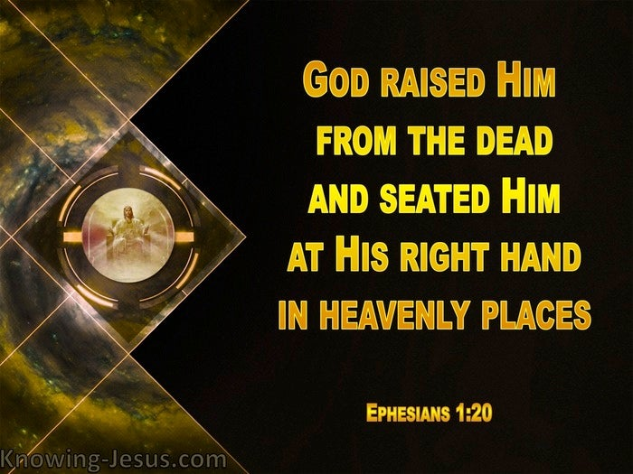

Slide 29
Ephesians 1:20 – 23
SECOND – God demonstrated His surpassing power when He seated Christ at His right hand (1:20). Forty days after being miraculously raised from the dead, the resurrected Messiah had completed His work of teaching and training His disciples to bring the gospel to the nations.
Then, as the disciples looked on, God exalted Him to the highest place of honor in the universe—God’s own right hand (Acts 1:1-10). Before the creation of the world, Christ shared in God the Father’s heavenly glory (John 1:1-2). Yet He voluntarily surrendered that position of great power and authority, taking on full humanity and humbling Himself as a servant and sacrifice for sin (John 1:14). And this wasn’t the end of the story.

Slide 30
Ephesians 1:20 – 23
After His resurrection, “God highly exalted Him, and bestowed on Him the name which is above every name” (Phil 2:9). He returned on high, taking to heaven His full and complete human nature—now glorified and immortal—so that He might be a perfect mediator between God and humanity (1Tim 2:5). What an indescribable example of God’s awesome power!
THIRD – God demonstrated His surpassing power when He put all things in subjection to Christ (1:21-22). Jesus’ position of vast authority over heaven and earth—present and future—was prophesied by King David long ago in the book of Psalms: “The Lord says to my Lord: Sit at my right hand until I make your enemies a footstool for your feet” (Psalm 110:1).

Slide 31
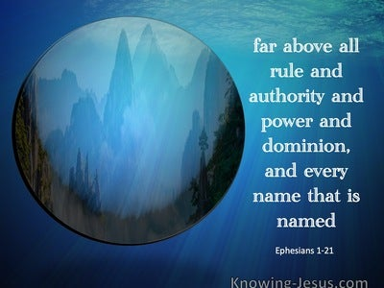

Slide 32
Ephesians 1:20 – 23
Being at the Father’s right hand means more than the restoration of the position of glory Christ had prior to His incarnation. It also means having divine authority as the fully human heir of David. As the perfect Man who was destined to rule on the throne of David (Luke 1:32), Jesus Christ will “shatter kings in the day of His wrath. He will judge among the nations” (Ps 110:5-6).
Christ is not only exalted above the earthly rulers but is also seated above the heavenly powers—both angelic and demonic (1:21; cf. 6:12). What an encouraging picture of God’s power granted to our victorious Savior!

Slide 33
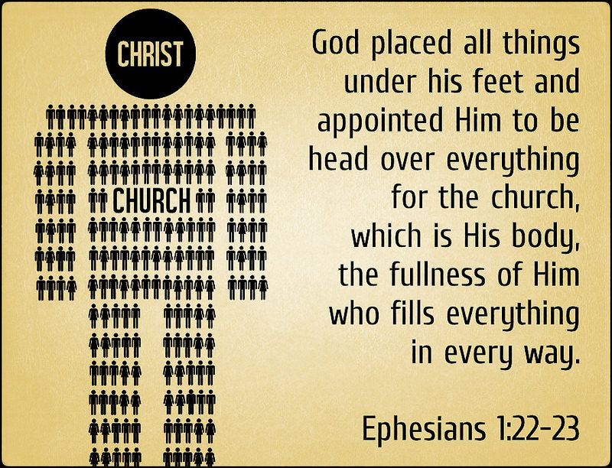

Slide 34
Ephesians 1:20 – 23
FOURTH – God demonstrated His surpassing power when He gave Christ to the church as head over all things (1:22-23). Christ arose victorious, having conquered sin, death, and the grave. He ascended on high, conquering the limitations of this earthly existence. He took His position in the place of authority over all things in heaven and on earth, things present and future.
Yet Paul points out particularly that God placed Christ over the church as its head—governing, shepherding, and leading His mystical body, the fullest manifestation of His work on earth in everything. Think about the amazing benefits this brings to believers, who are incorporated into the church through the baptizing work of the Holy Spirit (1Cor 12:12-13).

Slide 35
Ephesians 1:20 – 23
The ruler who sits on the throne of the universe is also our Brother and our Mediator before the Father (Rom 8:29; Heb 9:15). Paul’s description of the church as the body of Christ is not simply metaphorical imagery. It goes far deeper than that. Because the saints are united to Christ, his work has been applied to them as if they were literally in Him.
This is why Paul will later say of believers that God “made us alive together with Christ . . . And raised us up with Him, and seated us with Him in the heavenly places in Christ Jesus” (Eph 2:5-6). If we are members of His body, we are fully identified with the work of Christ. What an incomprehensible realization of the power of God!

Slide 36
Ephesians 1:20 – 23
Through praise (1:1-14), thanksgiving (1:15-16), and petition (1:17-23), Paul floods us with wave of profound truths that are difficult to comprehend in full.
So vast is the grace of God and so manifold its applications to our lives that we could literally spend a lifetime trying to grasp the depths of these realities.

Slide 37



Slide 38
NEXT CLASS – 18 May 2022
Book of Ephesians
Before next class, read the below verses in the NIV and in one other versions of the Bible, i.e., NKJV, NRSV, KJV, CEV, etc …
Chapter 2:1 – 10
“You Were Dead, But God …”

